Slide 1

U.S. Department of Veterans Affairs – VA Consolidation
Matthew Hedgecock, Senior Client Analyst
Mychal Graham, Enterprise Account Manager
May 2, 2018

Slide 2
Your ForeSee Team
Account Management
Mychal Graham
Enterprise Account Manager
Mychal.Graham@foresee.com
(734) 205-2578
Professional Services
Matthew Hedgecock
Senior Client Analyst, Data
Matthew.Hedgecock@foresee.com
(734) 352-6440
Headquarters
2500 Green Road, Suite 400 | Ann Arbor, MI 48105
Tel: (800) 621-2850 | Fax: (734) 205-2601
Cleveland Office 1111 Chester Avenue, Suite 101 Cleveland, OH 44114 (216) 812-3200
St. Louis Office 6665 Delmar Boulevard, Suite 3000 St. Louis, MO 63130
U.K. Office 49 Southwark Bridge Road London, SE1 9HH United Kingdom +44 (0) 20 3697 2361

Slide 3

Agenda
Aggregate Results
Convergence Issues
Recommendations
Methodology & Objective
Next Steps
This CX Strategic Analysis will highlight some of the brand convergence issues with Veterans Affairs websites. Recommendations on how to leverage the ForeSee survey to improve collection across VA sites will be provided.

Slide 4
Methodology & Objective

Slide 5
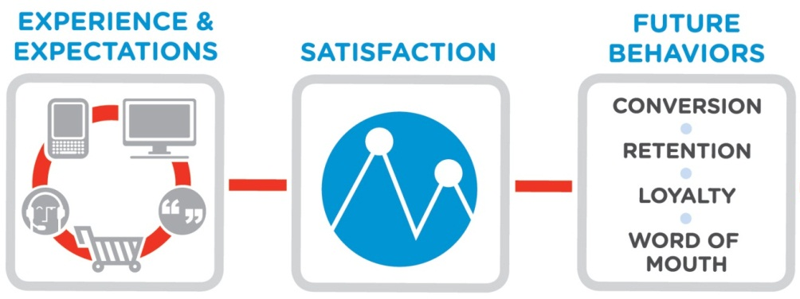
ForeSee Methodology
ForeSee applies proven science and technology to the measurement and analysis of the visitor experience through the lens of visitor satisfaction.
Analysis of the visitor experience will enable your organization to understand…
How are you doing?
What should you do?
Why should you do it?

Slide 6
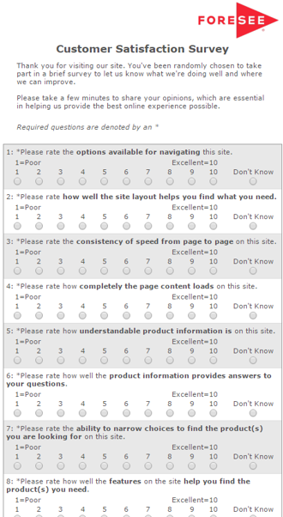

Capturing the Voice of Visitor
KEY FACTS
Collection began:
Desktop: August 2006
Reporting Period:
January 16, 2017 to March 31, 2018
Completion Percentage:
1
Visitor is on the department of Veterans Affairs website
2
Visitor is shown an invite
4 pages
1.35% sample
3
Accepting the invite loads hidden tracker window
N=4,061
Desktop
4
Survey goes to front when the site is exited
Desktop = 36.9%
*45%
*ForeSee Completion Percentage Benchmark
Notes:
Start simple – we use a survey

Slide 7
VA Main Aggregate Results

Slide 8
Information browsing has the strongest impact on VA main visitor satisfaction, followed closely by site information.
DRIVERS
OUTCOMES
Which drivers of customer experience should I address?
What’s the impact to my business?
SCORE |  | IMPACT
57 | Information Browsing | 2.1
72 | Look and Feel | 0.1
62 | Navigation | 1.0
59 | Site Information | 1.8
73 | Site Performance | 0.3
70.2
IMPACT |  | SCORE
4.2 | Primary Resource | 63
4.7 | Recommend Site | 63
3.3 | Return | 70
55.8
0
100
N=4,061
Desktop Satisfaction
Where am I right now?
How do I compare?

Slide 9
Satisfaction scores for VA Main are generally low, with the highest scores scoring just slightly above 60.
Satisfaction Score by Month
N: 254
N: 278
N: 177
N: 172
N: 179
N: 122
N: 151
N: 164
N: 144
N: 292
N: 698
N: 748

Slide 10
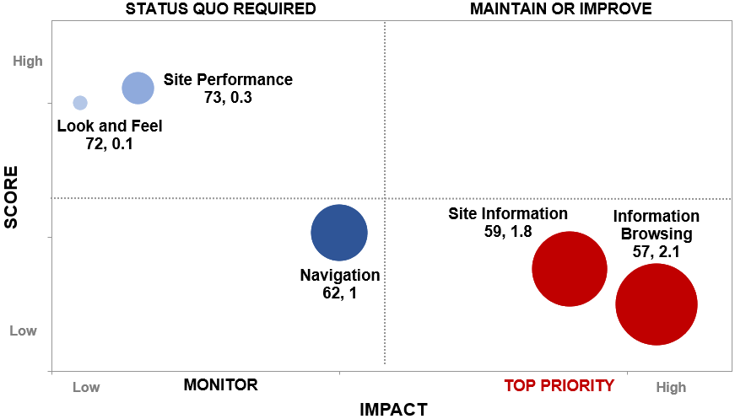
How well the site’s info answers questions, finding information, and narrowing choices are all areas in need of potential improvement.
N=4,061
Information Browsing
Site Information

Slide 11
The main VA site scores more than ten points below average for all relevant satisfaction benchmarks.
Satisfaction Benchmarks: March 2018
 | ForeSee Website Index | Public Sector - Desktop | Federal Government - Desktop | Portal - Desktop | Informational (General) - Desktop
MAX
Main VA Site
54
MIN
 BENCHMARK AVERAGE

Slide 12

Convergence Issues and Potential Resolutions

Slide 13




ForeSee measures the veteran experience across multiple websites and touchpoints to help the VA understand its constituency.
VA Main
N: 4,061
Q4 2017 Score: 56
VBA
N: 1,793
Q4 2017 Score: 66
My HealtheVet
N: 103,280
Q4 2017 Score: 78
VHA Med Centers
N: 7,911
Q4 2017 Score: 65
VA Blogs
N: 1,120
Q4 2017 Score: 63

Slide 14
Three of the five surveys are located within the VA.gov domain name, meaning that scores and feedback are closely related.
VA Main
N: 4,061
Q4 2017 Score: 56
VBA
N: 1,793
Q4 2017 Score: 66
VHA Med Centers
N: 7,911
Q4 2017 Score: 65
VA Blogs
N: 1,120
Q4 2017 Score: 63

Slide 15
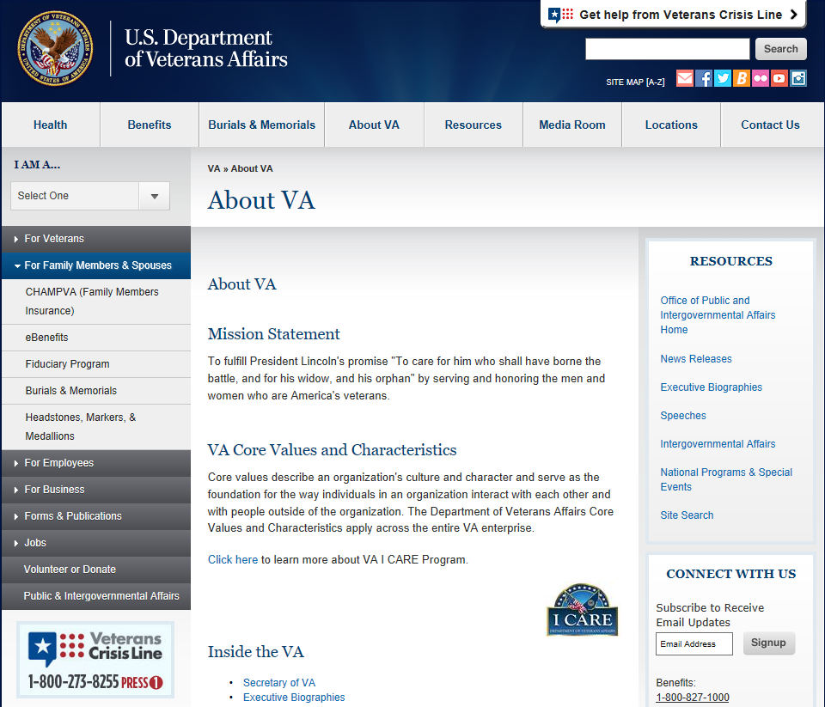
As a result, the main VA survey often serves as place for veterans to vent frustrations; they leave feedback about their entire experience.
VA Main
N: 4,061
Q4 2017 Score: 56
“Dept of Defense letter referred me to vabenefits.vba.gov/vonapp/main.asp but site removed/changed but no link of where to go. Did 4 searches, finally just went to forms.” – Sat: 52, 02/15/2018
“update the blogs most contain outdated information.” – Sat: 56, 02/14/2018
“CORRECT THE DRIVING DIRECTIONS TO THE NEW VA FACILITY IN OXNARD CA IMMEDIATELY. I intend to contact our congressional rep. again regarding this mater.” – Sat: 0, 09/28/2017

Slide 16
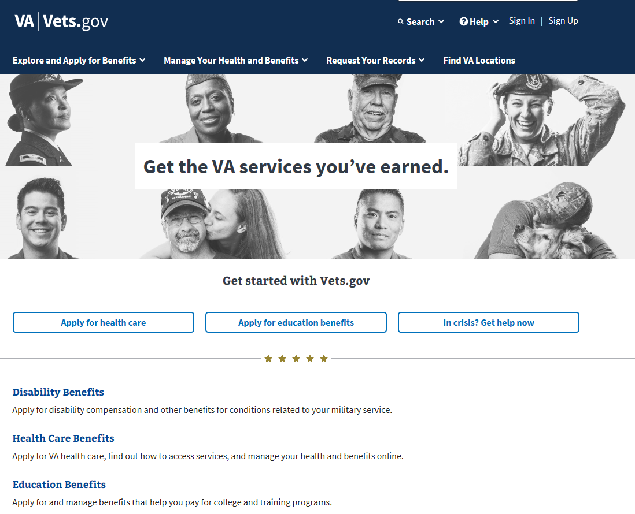
The issues that affect VA Main are intrinsic to the VA experience, and can be condensed to several key areas of concern.
Survey data shows:
The VA online experience is not keeping pace with changing expectations
The online experience is not friendly to new users
Information is not consistent or fully up-to-date
Younger veterans struggle on the site
Visitors in general struggle to find what they are looking for
Movement between VA sites is confusing and frustrating
1
2
3
4
5
6

Slide 17
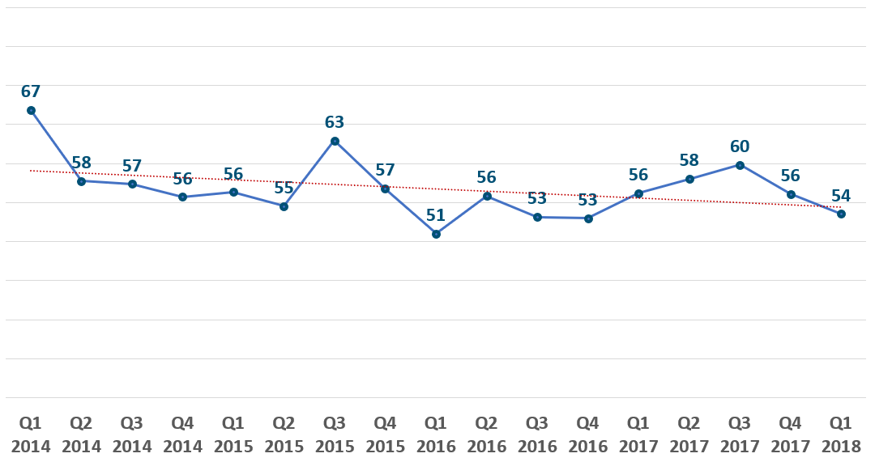
Satisfaction for the VA Main website has decreased over the past four years, perhaps reflecting tougher-to-meet expectations.
1
VA Main Satisfaction

Slide 18
First-time visitors can serve as a neutral party to determine how well a website works without any prior expectations.
How often do you visit the Veterans Affairs website (www.va.gov)?
2
SATISFACTION
55
52
57
59
61
53

Slide 19
First-time visitors typically score slightly lower when compared against repeat visitors, suggesting the site is hard to use for newbies.
2

Slide 20
Visitors to the main VA site have a number of recommendations for improvements, including broad updates and consistent info.
If you could suggest one improvement to the VA.gov web site, what would it be?
Update | Consistency
“Put BVA docket updates on site and keep information accurate.” Sat: 22, 3/30/18 “Stop worrying about how it looks and make sure the information veterans need is easily accessible. The website was much better a couple years ago, before it was changed to this new format. There are still issues with page links and it is very frustrating to have error messages come up when the "update" notice states it would be done the day before or longer.” Sat: 22, 03/22/18 “Someone to double check and update links as well as provide clarity to terms such as 'required documentation” Sat: 59, 03/01/18 “A simple list of benefits that 'may' be available, a translation of acronyms not generally known to the public and updated 'calculations tables' with the actual income limits as 'set by congress'. Simple questions beg only simple answers as a starting place.” Sat: 52, 03/13/17 | “Have consistent information across ebenefits and vets.gov and update ebenefits correctly as appeals trek through the extremely long appeals process.” Sat: 33, 03/23/18 “clear and consistent information, trying to update my dependents was very painful and I must've restarted/re-did each three times. (updating dependents, updating spouse, reviewing former spouse). The inconsistencies with log-ins are very frustrating also. Please fix this.” Sat: 0, 02/18/18 “DO NOT provide circular links (the nav bar at top: Contact Us > "Ask a Question" takes the user to the redirect dialog and then dumps them back on the iris.custhelp.com page again.” Sat: 18, 11/20/2017 “Better consistency. I am still not sure where to send an Aid and Attendance Request and will have to make phone calls tomorrow.” Sat: 37, 04/24/17
3

Slide 21
Most visitors who come to the main VA website are veterans, but their experience differs depending on their age.
Which of the following describe you? Please select all that apply.
4
67
56
54
61
62
59

Slide 22
Veterans of the two most recent conflicts account for at least one in five of all veterans, and they have lower satisfaction.
Please check the conflicts in which you served.
4
56
57
52
56
53
52

Slide 23
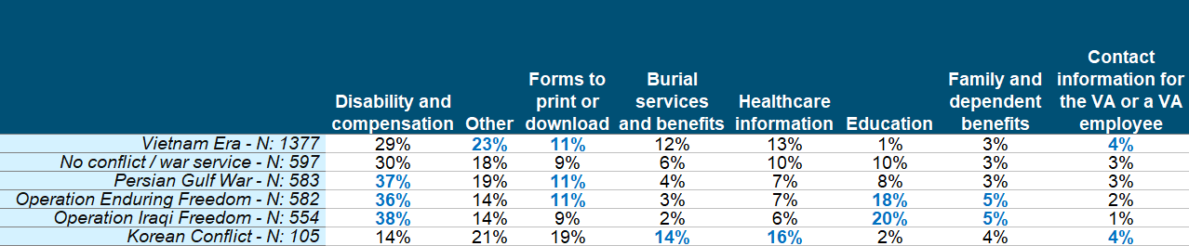
Younger veterans are more likely to be interested in disability and compensation information and education information.
Please check the conflicts in which you served. X What information were you primarily looking for today?
4

Slide 24
Visitors to the main VA site have a number of recommendations for improvements, including broad updates and consistent info.
If you could suggest one improvement to the VA.gov web site, what would it be?
Operation Enduring Freedom | Operation Iraqi Freedom
“Maybe just better access to submitted claims documents. I could never view my docs submitted and was unsure if they were in the proper area. Other than that, the site is very helpful and informative. Nice job with all the upgrades! Thank you for your support to our Veteran's.” Sat: 89, 3/24/18 “Make sure your forms work, and make sense. Make sure commonly needed info is easier to find. It's absurd that I spent an hour trying to find a claim number. It's also absurd that your required fields in the contact form are so broken.” Sat: 0, 03/22/18 “have an easy access for how much of my benefit still exists” Sat: 26, 02/26/2018 “clear and consistent information, trying to update my dependents was very painful and I must've restarted/re-did each three times. (updating dependents, updating spouse, reviewing former spouse). The inconsistencies with log-ins are very frustrating also. Please fix this.” Sat: 0, 02/18/18 | “An eventual merge with TRICARE online. I can obtain a lot of my medical information from their site, so it would be great if it were all in one system. That way, if I seek treatment at the VA, they can access the same information provided at my primary medical treatment facility.” Sat: 100, 03/30/18 “Better navigation tools and options. I find what I am looking for eventually, but it does take persistence. My fear is other vets who are not as persistent or tech and health savvy may not be well served by this VA portal.” Sat: 37, 03/28/18 “Maybe just better access to submitted claims documents. I could never view my docs submitted and was unsure if they were in the proper area. Other than that, the site is very helpful and informative. Nice job with all the upgrades! Thank you for your support to our Veteran's.” Sat: 18, 11/20/2017
4

Slide 25
Visitors across several Veterans Affairs sites struggle to find what it is they are looking for.
Did you accomplish what you wanted to?
VA Main Site
VHA Medical Centers
VBA
VA Vantage Point
Sat: 64
Sat: 71
Sat: 29
5
Sat: 31
Sat: 87
Sat: 80
Sat: 85
Sat: 36
Sat: 86
Sat: 36
Sat: 88
n=4,061
n=7,911
n=1,793
n=1,120
Standardized answer choices would allow for easier comparative analysis.
Sat: 74

Slide 26
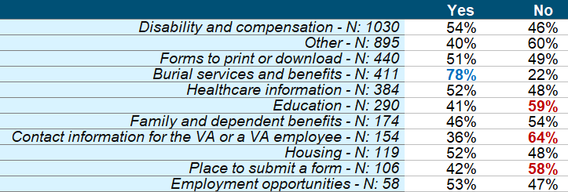
Education, finding contact information, and finding a place to submit a form have the lowest rates of success on the VA Main site.
Please check the conflicts in which you served. X What information were you primarily looking for today?
VA Main Site
5

Slide 27
Visitors to the main VA site have a number of recommendations for improvements, including broad updates and consistent info.
If you could suggest one improvement to the VA.gov web site, what would it be?
Education | Submit a Form
“None of the Education applications worked for me today. I've attempted multiple times over the last 2 days and have received the following error: Unexpected Error We're sorry, but an unexpected error has occurred. Please return to the main site and try again. Customer Support Information.” Sat: 11, 03/26/18 “information about available education benefits was unavailable. site appeared to be down or time of day may have been the issue... 2251 est.” Sat: 70, 03/14/18 “Education enrollment status is limited to the time the VA opens and closes. I don't understand why I cant look at my education benefits because it is not between 10am-6pm eastern time smdh.” Sat: 0, 03/01/2018 “for the past month I have been trying to see if my education attendance has been reported and I can not see if I am being reported to the VA as a student and I call everyday with no answer.” Sat: 0, 02/26/18 | “An eventual merge with TRICARE online. I can obtain a lot of my medical information from their site, so it would be great if it were all in one system. That way, if I seek treatment at the VA, they can access the same information provided at my primary medical treatment facility.” Sat: 100, 03/30/18 “Better navigation tools and options. I find what I am looking for eventually, but it does take persistence. My fear is other vets who are not as persistent or tech and health savvy may not be well served by this VA portal.” Sat: 37, 03/28/18 “Maybe just better access to submitted claims documents. I could never view my docs submitted and was unsure if they were in the proper area. Other than that, the site is very helpful and informative. Nice job with all the upgrades! Thank you for your support to our Veteran's.” Sat: 18, 11/20/2017
5

Slide 28
Visitors who access a different VA site before taking the VA Main survey have lower satisfaction than those who do not.
Have you visited any other Veterans Affairs websites during your browsing experience today?
Which sites did you visit during your online experience today? Please select all that apply.
VA Main Site
6
Sat: 58
Sat: 47
Sat: 52
n=4,061
56
55
46
57
41

Slide 29
Visitors who came to the VA Main site from VA-affiliated websites have lower satisfaction than the aggregate score.
DRIVERS
OUTCOMES
Which drivers of customer experience should I address?
What’s the impact to my business?
SCORE |  | IMPACT
48 | Information Browsing | 2.4
68 | Look and Feel | 0.0
55 | Navigation | 0.7
51 | Site Information | 1.9
71 | Site Performance | 0.3
70.2
IMPACT |  | SCORE
4.4 | Primary Resource | 55
4.7 | Recommend Site | 54
3.5 | Return | 64
6
47.0
0
100
N=835
Visitors Who Came From a VA Affiliated Site
Where am I right now?
How do I compare?

Slide 30
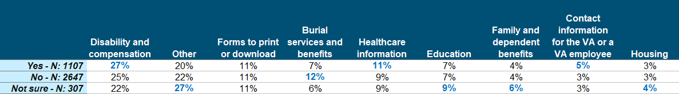
Visitors who have to pass through multiple VA sites are more likely to be looking for disability information and healthcare information.
Have you visited any other Veterans Affairs websites during your browsing experience today?
X
What information were you primarily looking for today?
6
Sat: 58
56
55
46
57
41

Slide 31
Respondents regularly call for improvements that apply to sites other than VA Main, suggesting a sense of disorientation.
If you could suggest one improvement to the VA.gov web site, what would it be?
Password | Account
“I don't come to this site often When I do I always have login issues due to the fact I don't have a need to use this site on a regular bases Lt me decide when to change my password I don't like it when a site tells me what I can and can't use as a password and when to change my password. I won't remember the password I just changed because of your criteria. It's my password.” Sat: 63, 03/14/18 “make passwords easier to use. There are too many rules, such as not being able to use dictionary words, etc. Its really hard for me to remember them, especially since they have to be changed every 90 days.” Sat: 78, 02/20/18 “a lot of problems signing into my eBenefits account. keep telling me user name or password was incorrect. Took me 4 attempts.” Sat: 44, 02/11/2018 “Sign in security for forgotten passwords was almost impossible....only prob I had other wise VERY HAPPY.” Sat: 100, 02/05/18 | “provide online registration as stated in your correspondence for updating your account online.” Sat: 100, 03/30/18 “Make it easier to locate the site and information to apply for the Premium Level II account. I give up and need HELP. I am very computer literate by the way.” Sat: 0, 03/26/18 “a lot of problems signing into my eBenefits account. keep telling me user name or password was incorrect. Took me 4 attempts.” Sat: 18, 11/20/2017 “Have more details about your account and where to submit supporting documents.” Sat: 0, 09/18/2017 “Re do the site and make it much easyer to find your account and get needed information.” Sat: 4, 06/10/2017
6

Slide 32
Next Steps

Slide 33
Standardizing questionnaires across the VA family of sites will benefit cross-site analysis and could foster in-depth comparisons.
Questions That Should Be on Every VA Survey
Did you access another VA site during your online browsing today?
What other VA sites did you access?
Make sure answers are standardized
Are you a veteran? (or have veteran as a primary role)
During what conflict did you serve?
Make sure answers are standardized
Standardize answers for all shared “common” questions like
Visit Frequency
Task Accomplishment
Visitor Role

Slide 34
Key Findings & Recommendations
Content
Continue to enhance and streamline website content, especially content that is related to disability and compensation and healthcare information.
This recommendation could apply across VA websites; in the case of content spread across multiple sites, consistency is key.
Pathfinding
Movement between different VA websites can leave visitors confused about where they should turn first for information.
Better distinctions about which branch of the agency is considered the “authority” for particular information would help visitors know where to turn to in the event of confusion. Additionally, it would prevent them from cycling through multiple VA sites.
Ensure that changes to sites help keep the VA online experience current and in-line with modern expectations.
This does not necessarily mean a “slick” experience or look and feel, but rather simplified navigation that connects visitors to their desired information quickly.
A unified strategy for agency improvements and long-term planning would be needed to achieve the brand consolidation goals.
Update
Notes:
Our recommendations are threefold based on our key findings

Slide 35
Next Steps
Schedule time to walk through the portal and cxSuite.
ForeSee analyst is available to walk new contact through data, portal access, and available future deliverables.
1
Plan the next CXSA for July/August delivery.
Potential scopes include analysis of any new custom questions, or ranking requests for features and changes that visitors want to see on the site.
Discuss goals and plans for VA Main in the forthcoming year and work to create a deliverable plan.
2

Slide 36
Appendix

Slide 37
VA Vantage Point Blog Aggregate Results

Slide 38
Capturing the Voice of Visitor
KEY FACTS
Collection began:
Desktop: May 25, 2017
Reporting Period:
May 25, 2017 to March 31, 2018
Completion Percentage:
1
Visitor is on the VA Vantage Point blog site
2
Visitor is shown an invite
2 pages
30% sample
3
Accepting the invite loads hidden tracker window
N=1,120
Desktop
4
Survey goes to front when the site is exited
Desktop = 39.9%
*45%
*ForeSee Completion Percentage Benchmark
Notes:
Start simple – we use a survey

Slide 39
The actual information on the VA Vantage Point blog has the greatest impact on visitors’ overall satisfaction.
DRIVERS
OUTCOMES
Which drivers of customer experience should I address?
What’s the impact to my business?
SCORE |  | IMPACT
72 | Information Browsing | 1.2
68 | Look and Feel | 1.5
78 | Navigation | 0.5
70 | Site Information | 2.1
80 | Site Performance | 0.4
70.2
IMPACT |  | SCORE
2.8 | Follow on Social Media | 63
4.7 | Recommend | 63
4.1 | Return | 70
3.9 | Share Information | 69
66.8
0
100
N=1,120
Desktop Satisfaction
Where am I right now?
How do I compare?

Slide 40
Satisfaction scores for VA Main are generally low, with the highest scores scoring just slightly above 60.
N: 23
N: 113
N: 98
N: 77
N: 90
N: 74
N: 94
N: 258
N: 96
N: 106
N: 91

Slide 41
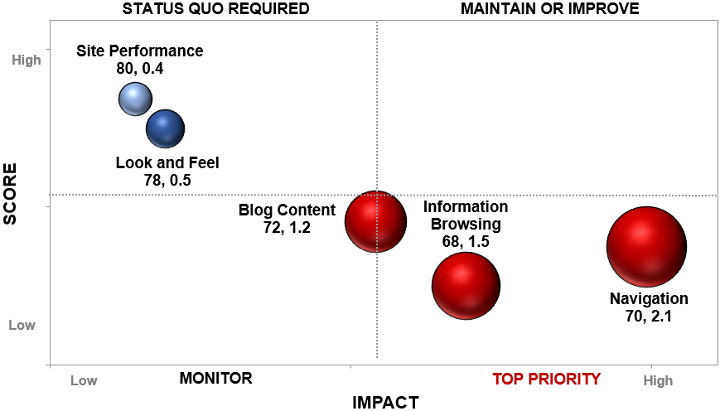
Information browsing has the lowest scoring overall questions, especially how well the blog features help visitors find things.
Blog Content
N=1,120
Information Browsing
Navigation

Slide 42
The VA Vantage Point blog scores well below average for all relevant satisfaction benchmarks.
Satisfaction Benchmarks: March 2018
 | ForeSee Website Index | Public Sector - Desktop | Federal Government - Desktop | Portal - Desktop | Informational (General) - Desktop
MAX
VA Vantage Point
62
MIN
 BENCHMARK AVERAGE

Slide 43
Appendix - Glossary of ForeSee Terminology
The ForeSee ® CXASM Methodology: The ForeSee CXA methodology is an advanced statistical engine proven by years of research that measures the customer experience and utilizes cause-and-effect modeling to radically change the way that organizations make strategic investments and decisions for better bottom-line results. Backed by three decades of rigorous scientific research, ForeSee CXA methodology has a rich heritage of highly diagnostic performance measurements coupled with sensitive improvement prescriptions and powerful prognostic capabilities.
Custom Questions: Each Customer Satisfaction Survey includes two different types of questions: model questions and custom questions. Custom questions are unique to each survey and can take a variety of different forms, including radio buttons, drop-down menus, check boxes, and open-ended text. The custom question responses are not used to derive the results using the ForeSee CXA methodology; so custom question results are reported separately in the Online Reporting Facility. Custom questions provide an excellent opportunity for data segment analysis.
Elements: An element is a measure of the customer's experience with a defined and manageable property of a website (e.g., Look and Feel, Navigation, etc.). It is composed of several survey items that provide performance ratings about various aspects of the customer's experience with the website property being measured. The separate ratings are combined as part of the modeling process into a summary score reflecting the overall experience of the customer with the website property.
Random Sampling: We use a Sampling Percentage to determine the proportion of site visitors that will receive a survey invitation on your site. We try to attain a good balance between collecting enough information to provide you with in-depth analysis, while remaining unobtrusive to your site visitors.
Impact: Impact is the numeric representation of the cause-and-effect relationship between an element (e.g., Site Navigation) and customer satisfaction or customer satisfaction and a future behavior (e.g., Likelihood to Purchase). An impact represents the increase in customer satisfaction resulting from a 5-point increase in an element score. For example, if the impact of Site Navigation is 1.2, then a 5-point increase in Site Navigation’s score would lead to an increase in customer satisfaction by 1.2 points.
Loyalty Factor: The Loyalty Factor is a number that establishes how many pages with survey code a site visitor must visit before they are eligible to receive a survey. Loyalty Factors are utilized to ensure that respondents have experienced enough of a site before completing the Customer Satisfaction Survey.
Model Questions: In order to utilize the ForeSee CXA methodology to calculate Satisfaction and Future Behavior scores and impacts, ForeSee asks standard model questions. These model questions are targeted toward the key Elements (i.e., “main areas”) of the site that drive customer satisfaction (e.g., Functionality, Navigation, Product Browsing, etc.), Overall Satisfaction, and Future Behaviors such as Likelihood to Recommend or Likelihood to Purchase.
Future Behaviors: Future Behaviors are the things you want your customers to do more of as a result of visiting your website, such as recommend your site to others or complete a purchase. The cause-and-effect ForeSee CXA methodology enables us to quantify the impact that improving satisfaction with your site would have on increasing future behaviors such as site visitors’ likelihood to recommend your site.

Slide 44

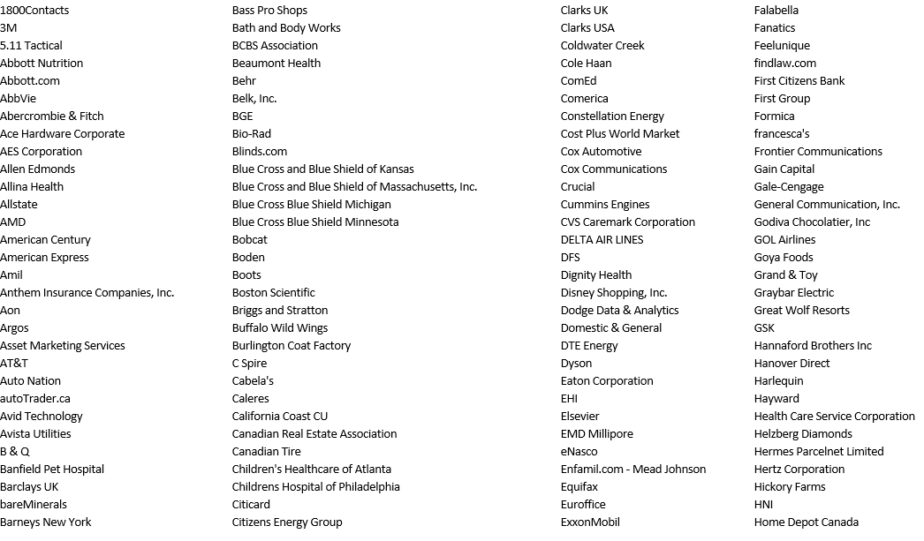
Appendix – Benchmark Participants

Slide 45
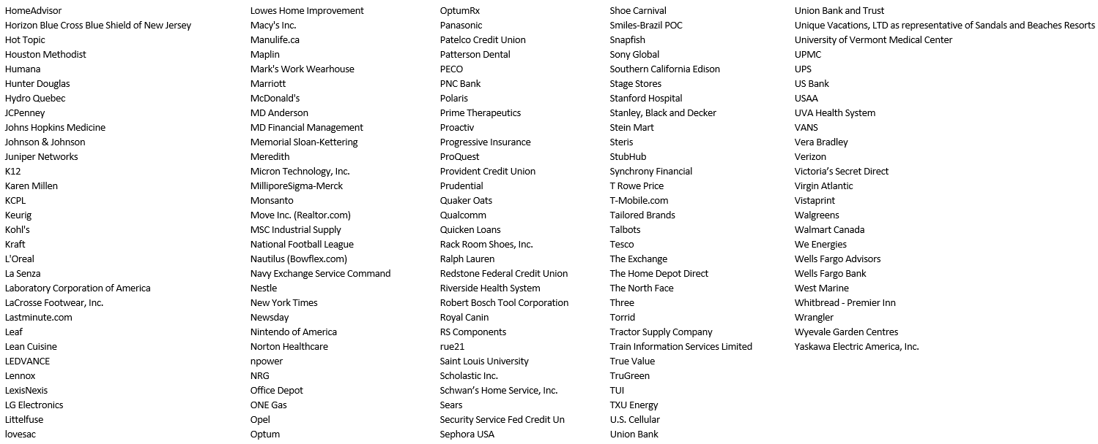
Appendix – Benchmark Participants

Slide 46
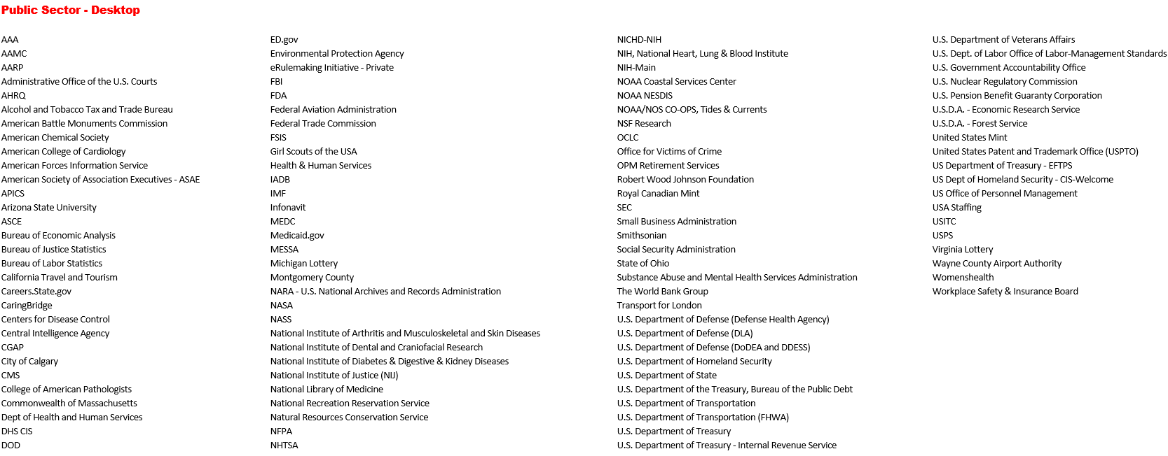
Appendix – Benchmark Participants

Slide 47
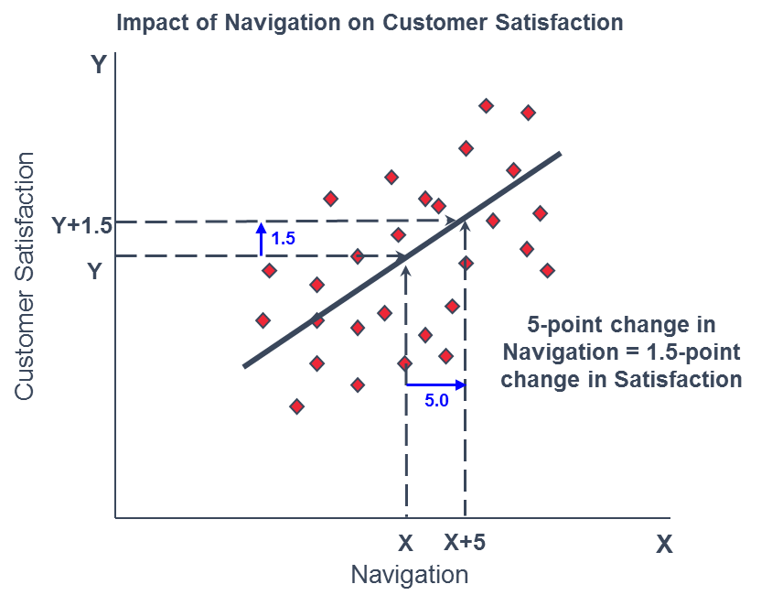
Understanding Impacts
The rate of change between an element and satisfaction is represented by an Impact. In simple terms, an impact can be understood as something like a slope of a line defining the relationship between two variables.

